Slide 1





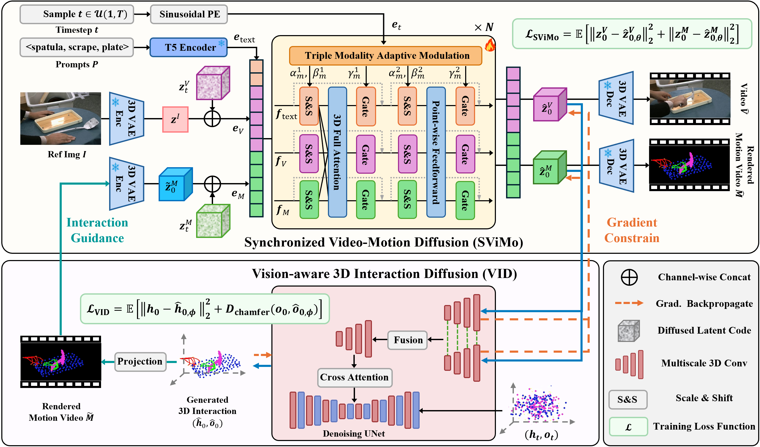
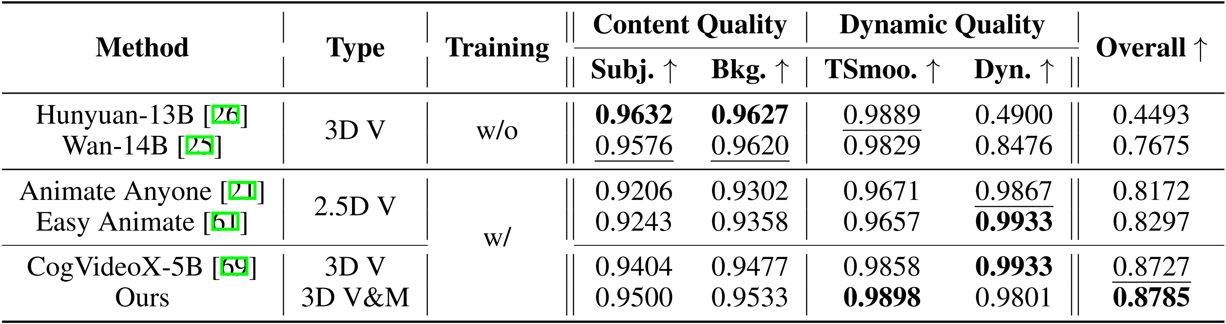
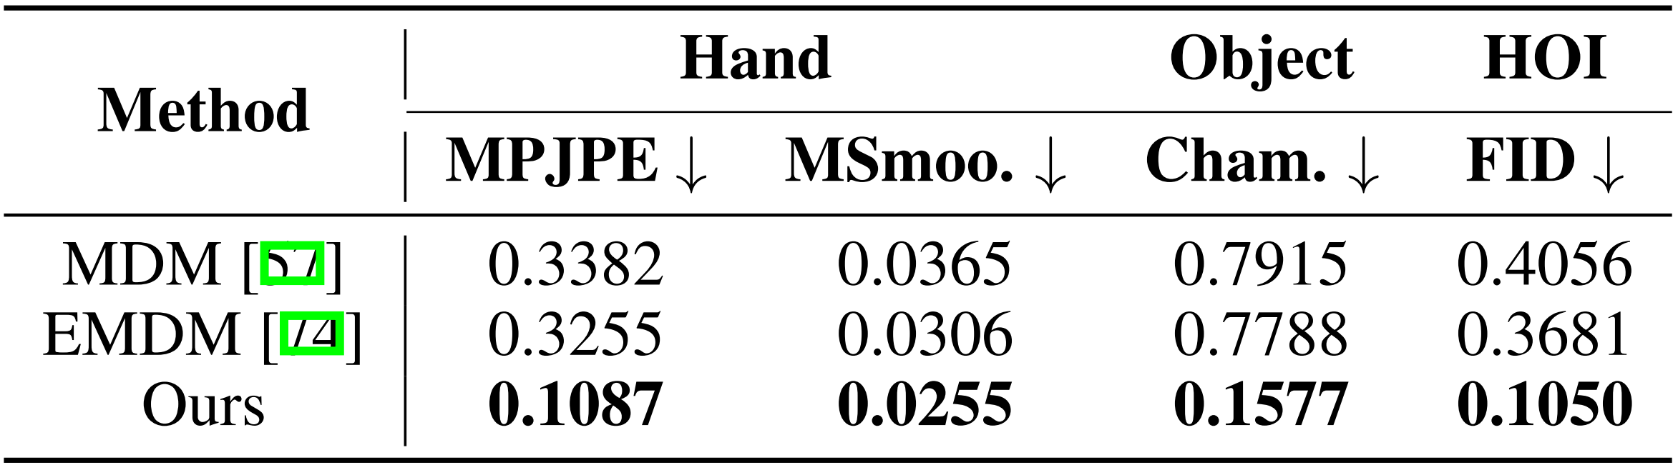
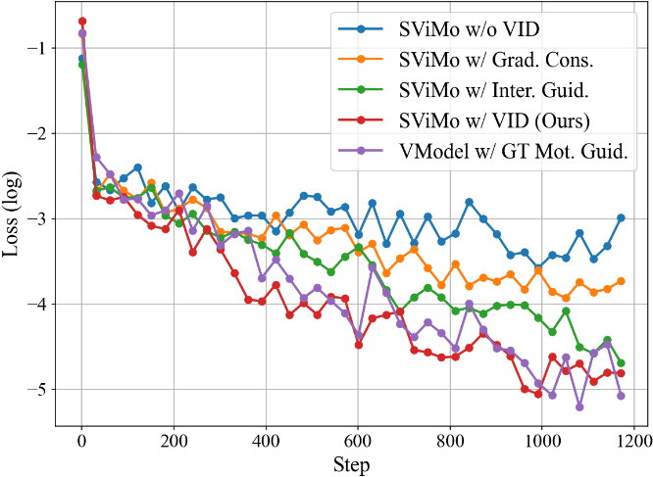
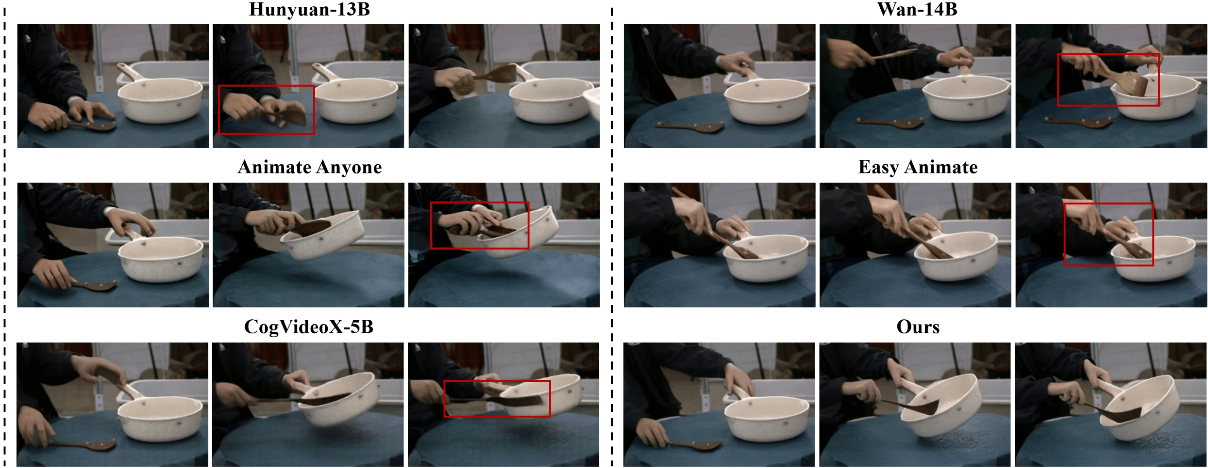
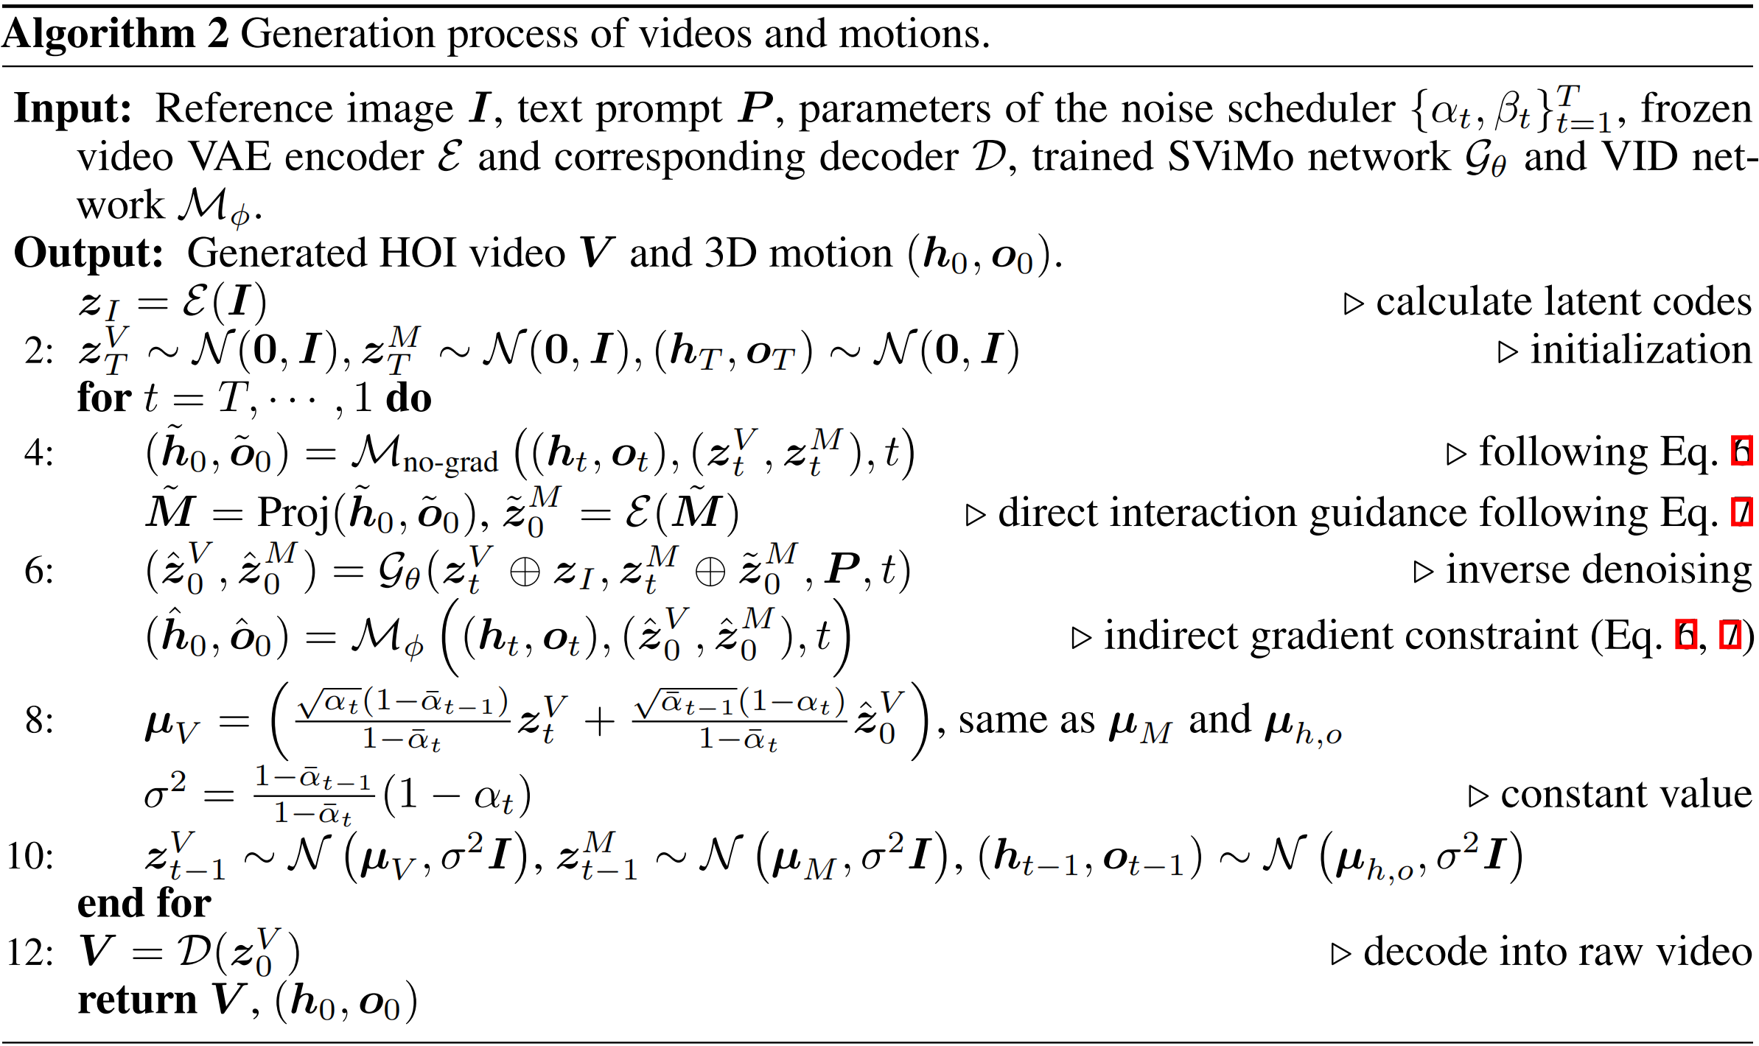
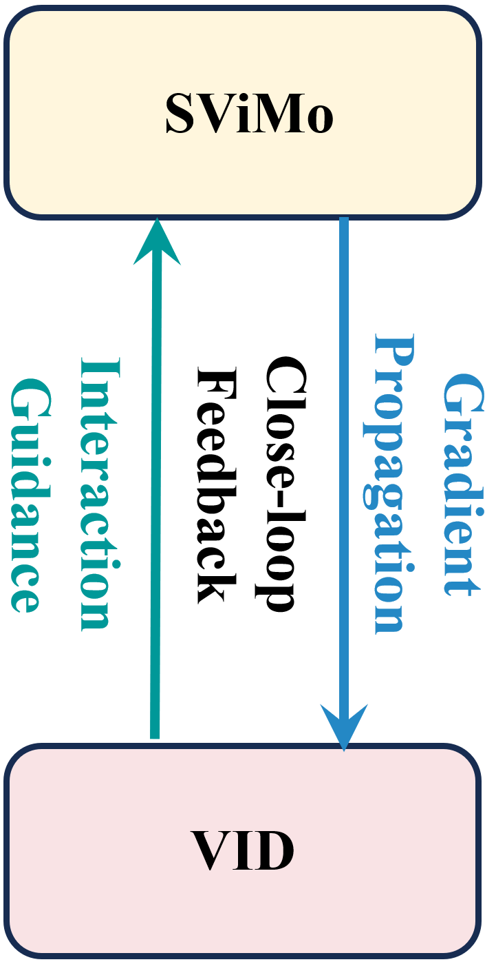
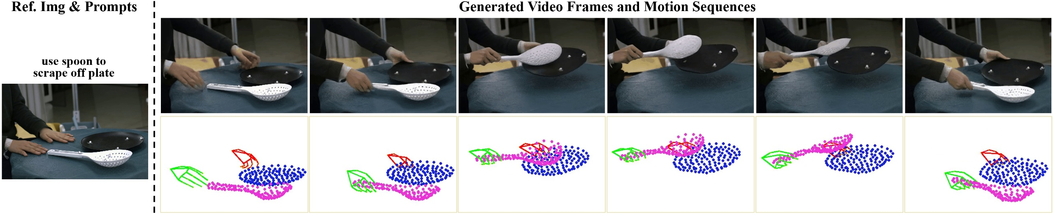
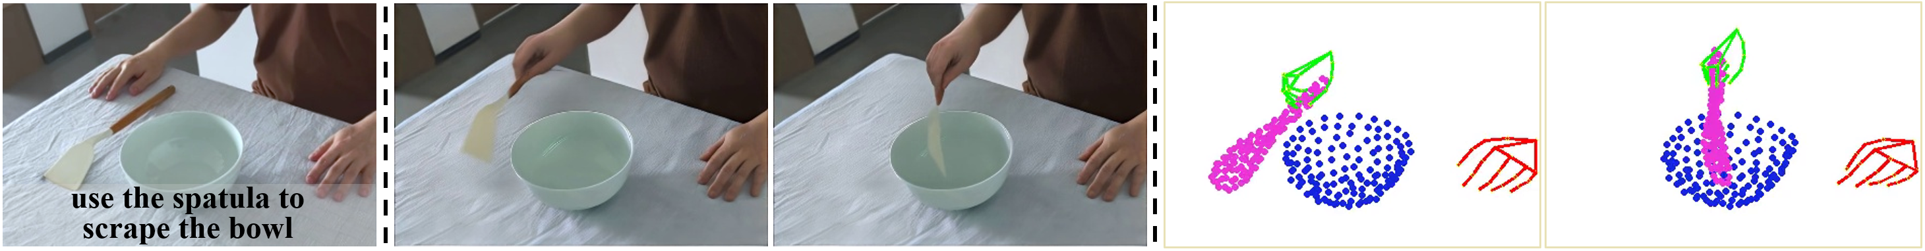


SViMo: Synchronized Diffusion for Video and Motion Generation in Hand-object Interaction Scenarios
Lingwei Dang$^{1∗}$, Ruizhi Shao$^{2∗}$, Hongwen Zhang$^{3}$, Wei MIN$^{4}$, Yebin Liu$^{2}$ , Qingyao Wu$^{\text{†}1}$
$^{1}$South China University of Technology, $^{2}$Tsinghua University, $^{3}$Beijing Normal University , $^{4}$Shadow AI
Background & Motivation
Method
Experiments
Broad Applications: Hand-object interaction (HOI) generation holds significant potential in gaming, animation, digital human creation, and robotics.
Existing Video models lack physical awareness, and motion models rely on limited 3D lab data, hindering generalization.
Our Insight: Visual appearance and motion dynamics share the same physical laws. We propose to unify visual priors and kinematic constraints through synchronized video-motion co-generation.
Overall Pipeline
Quantitative Comparison
Contributions
Qualitative Comparison
A novel synchronized diffusion model for joint HOI video and motion denoising, effectively integrating large-scale visual priors with motion dynamic constraints.
A vision-aware 3D interaction diffusion that generates explicit 3D interaction sequences, forming a close-loop optimization pipeline and enhancing video-motion consistency.
Our method generates HOI video and motion synchronously without requiring pre-defined poses or object models. Experiment results demonstrate superior visual quality, motion plausibility, and generalization capability to unseen real-world data.
Pseudo-code for the Inference Phases
Simplified Diagram
Demonstration of Our Generated Video and Motion
Dataset & Metrics
Dataset: TACO
Metrics: VBench metrics, MPJPE, Chamfer Dist, Smoothness, FID
Project: https://droliven.github.io/SViMo_project/
Generalization on the Real-World Data
[1] Cogvideox: Text-to-video diffusion models with an expert transformer. ICLR 2025.
[2] VideoJAM: Joint appearance-motion representations for enhanced motion generation in video models. ICML 2025 Oral.
[3] Easyanimate: A high-performance long video generation method based on transformer architecture. ACM MM 2025.
[4] Animate anyone: Consistent and controllable image-to-video synthesis for character animation. CVPR 2024.
This work was supported by the National Natural Science Foundation of China (NSFC) No.62125107 and No.62272172.
Key References
Acknowledgement

